Slide 1
Science Policy Careers
Pat Phelps, PhD
Director, Professional Development and Careers Office

Slide 2
What is Science Policy
Science policy experts serve as the bridge between researchers, the public and legislative policy. They communicate science to legislators and communicate policy to scientists.
How can we use scientific collaborations with other nations to improve diplomatic relations?
How can we improve the success of women and minorities in science and technology fields?
What does science look like (how is it funded?, what is government’s role? and how do we decide what to fund?) in a low growth economy.
How can we mitigate the threat of infectious diseases like Ebola or Zika?
What are the implications of biological warfare?
How will climate change impact us and what can we still do to slow its progression?
How do we continue to feed and provide water to the global population?
What can be done to improve health care while reducing costs?
Notes:
What do Science Policy Professionals Do?
Science policy experts serve as the bridge between researchers, the public and legislative policy. They communicate science to legislators and communicate policy to scientists.
A good way to understand science policy is to think about the questions science policy is grappling with. Science policy is basically a set of questions about science and society.
What are the economics of antibiotic drug resistance?
Should vaccinations be mandated?
What are the ethical and moral boundaries of humans editing their own genome?
If you like thinking about these questions, science policy may be a great career for you.

Slide 3
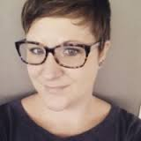
Laura Koontz, Ph.D.
Director of Policy, Ovarian Cancer National Alliance
“If you're interested in a career in science policy, be prepared to write, write, and then write some more! As a policy analyst, you may be called upon the read and summarize, analyze, and comment upon how
specific legislation, federal and state regulations, and policy proposals may impact your organization or constituency. You may even be the person drafting those proposals and will need to clearly and effectively explain to others why they should support your policy. In any position, you'll likely work in close collaboration with other stakeholder groups.”
Notes:
Our alumni are always willing to share their career experiences. You can follow Laura Koontz on Twitter where she is quite active on science policy issues. We have heard that the best way to find jobs in the DC science policy arena is on TWITTER.

Slide 4
Pamela Bradley, Ph.D.
Personalized Medicine Staff, Office of In Vitro Diagnostics and Radiological Health, Center
for Devices and Radiological Health, U.S. Food and Drug Administration
"It’s tough to describe a typical “day in the life,” since life in the policy world is unpredictable and varied. Some days I spend all day glued to my desk, only writing and reading emails. Other days, I delve into primary scientific literature or write technical documents. Still other days, I am focused on our communication and outreach efforts to help educate industry about the current thinking of the Agency, which may involve informal meetings, oral presentations or developing written material. It helps to be flexible because my to-do list frequently gets shoved aside for a more pressing matter. People skills also come in handy since identifying appropriate policy solutions often requires working collaboratively to find
consensus among stakeholders whose goals are divergent and often not well aligned. A warning to scientists: policy change often happens at the same glacial pace as research advances in a lab, so you will need patience, flexibility and the ability to compromise! I have found science policy to be a rewarding career path, with exciting opportunities to contribute to public health on a broader scale.”
Notes:
I love how Pamela Bradley, Personalized Medicine Staff at FDA, shared that science policy moves at the same glacial pace as research. That is a common comment I have heard many science policy professionals share – this is not a career for someone seeking instant gratification but they all agree you can create change and that it is a very rewarding career.

Slide 5
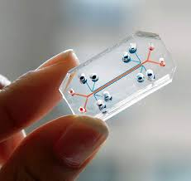
Health Policy Analyst National Institutes of Health
Facilitate the management of PRISMS, a 9-lab cooperative agreement focused on wearable environmental and physiological monitors for asthmatic children.
Provide programmatic support in multiple scientific areas: Organ-on-a-Chip, Tissue Engineering, Drug Delivery, Point-of-Care Technologies.
Conduct in-depth analyses of significant scientific and programmatic issues to guide the NIBIB research agenda.
Notes:
This is an example of a science policy professionals LinkedIn description of their job responsibilities. One important message I like to share about careers is not all Science Policy jobs are the same. Some science policy professionals may interact with congress and politicians while some science policy professionals may never meet a politician. Some positions may engage with people on a daily basis while some positions are more research and writing focused. A great way to find out what different science policy professionals do is to read LinkedIn profiles. A Linkedin search can reveal organizations that hire science policy professionals, enhance your understanding of the career, identify common steps or training experiences PhDs took to land a science policy career, identify professional organizations they follow, common skills they have and highlight professionals who you can network with.

Slide 6
Senior Science Policy Analyst National Institute Neurological Disorders and Stroke
Coordination and oversight of the NIH BRAIN Initiative.
The work of NINDS's Office of Scientific Liaison, tasked with communicating information on the basic and translational research funded by NINDS to diverse scientific audiences.
The work of the Office of Pain Policy, tasked with coordinating and managing activities of NIH's Pain Consortium and HHS's Interagency Pain Research Coordinating Committee.
I also serve as Executive Secretary and NIH liaison for the Neuroethics Workgroup of the BRAIN Multi-Council Working Group.
Notes:
This is another alumni’s LinkedIn profile description of their position at NIH

Slide 7
Advocacy and Science Policy EveryLife Foundation for Rare Diseases
Managed legislative efforts on behalf of patients and industry in the rare disease community.
Led congressional advocacy initiatives, program development, and science policy efforts.
Current legislative priority is passing a law to incentivize companies to repurpose drugs for rare disease indications by offering market exclusivity extensions (OPEN ACT HR 971).
Foundation lead on regulatory affairs efforts related to rare disease drug development and policy at the Food & Drug Administration (FDA).
Notes:
This is a alumni’s position at a non profit for Rare Disease

Slide 8
Senior Policy Analyst, Association of American Medical Colleges
Cover a broad portfolio of issues in science policy.
Use various analyses to create a data-driven understanding of research trends and emerging issues in the scientific and medical community.
Generate regular reports and synopsis to support AAMC’s priorities regarding the NIH and other federal agencies.
Notes:
This is a position at a scientific society. Take a few minutes after this presentation to find some more science policy professionals LinkedIn profiles and gain a better understanding of all the options available. You will be surprised at how many people are working in this field.

Slide 9
What are the Day to Day Tasks?
Collect and compile background information on a particular issue, and write a summary document that explains all sides of the issue
Advocate for increased funding for particular programs
Write talking points on a particular hot topic on a short deadline
Organize conferences or panel discussions, where scientific experts present the latest results in a particular field
Inform scientists about the impacts of new or changed legislation on their research
Assess the uses, benefits and economic impacts of technology or programs, by collecting and analyzing data on effectiveness
Interpret laws, regulations, agency policy manuals and directives to identify how these regulations may impact potential developments
Review documents to ensure that proper technical and professional procedures were followed, and that all recommendations are in line with applicable statutory, regulator and policy guidance requirements
Notes:
The million dollar question – what will I do? If the million dollar question was what will I make? – The answer is as a PhD you will most likely start at between $60K and $80K.

Slide 10
JOB ADVERTISEMENT
The successful applicant will become part of a project team that supports NIH projects and clients. Support could include data analysis, policy research, analytical writing, project management, and process improvement. As this position will involve close interaction with our clients, superior communication and organizational skills are required. Project duties may require assisting with researching guidance and regulations, drafting answers to questions from organizations and individuals participating in the programs, documenting decisions, helping groups and committees reach consensus, and working in a team. The successful applicant should have a thorough understanding of biomedical research and policy. A sampling of tasks may include:
Writing and editing policy documents based on changing regulation and policy
Supporting new policy implementation across internal NIH staff and the external community
Preforming qualitative and quantitative analysis to evaluate the effectiveness of policies and programs
Facilitates meetings in support of NIH policies and systems
Collection and preparation of data from surveys and administrative information systems
Providing content and editorial support for briefings and notices
Conducting literature searches and review to provide background information for related project topics
Prepare for and summarize client communications and correspondence
Tracking internal project functions, specifically the progress of tasks
Addresses technical issues with documents to ensure 508 compliance and consistency in a number of formats including HTML, PDF and Word
Notes:
I always encourage trainees interested in a specific career to look at job advertisements. Does it sound exciting, is it something you would enjoy doing? This was a contract position that supported NIH initiatives.

Slide 11
Where Will You Work?
The Hill
The White House
NIH
Foundations
Think Tanks
The State Department
State Governments
Federal Agencies (DOE, DOD, USDA, NSF, FDA, CDC)
Professional societies
NGOs
Academic Institutions
Notes:
Most Science policy jobs are in Washington DC or at NIH. Many academic institutions have science policy centers where PhDs find positions. Check out Debra Matthews job in the Johns Hopkins Berman Institute on Bioethics.

Slide 12
What skills are required?
Excellent oral and written communication skills
Ability to enthusiastically translate complex information to lay audiences
Ability to conduct thorough research quickly, and to work independently
Interest in a wide variety of scientific issues
Negotiating skills, and confidence to be able to debate professionally
Ability to see the big picture, and analytical skills to critically evaluate all sides of an issue (scientific, political, economic, etc.)
Interpersonal skills to build relationships with key people, and diplomacy to work with people with whom you disagree
Notes:
Communication skills are important for most careers but they are essential for science policy!

Slide 13
Job Requirements
Effective oral and written communication skills
Outstanding interpersonal and customer service skills to interface with internal and external customers
Demonstrated interest in science advocacy
Strong collaborative skills and ability to organize work across departments to achieve common objectives.
Attention to detail and accuracy.
Ability to multi-task and set priorities in a flexible manner to address changing needs.
Advanced competence in computer software applications and related technology products, including database systems and proficiency in Windows, MS Office Suite,
Experience with content management system and association management system are a plus.
Ability to work independently as well as in a team environment, and to exercise sound judgment.
Notes:
Reviewing job ads can also help you identify the skills you need to develop.

Slide 14
Developing Skills for a Competitive Fellowship Applications
Network
Join AAAS Science and Technology Policy Fellows LinkedIn Group
Sign up for Science and Technology Policy Fellows Newsletter
Find Science Policy mentors – conduct informational interviews with alumni and career professionals
Science Policy Happy Hours in DC
Subscribe to Washington Science Policy Alliance Listserv
Write
Blog for Johns Hopkins Biomedical Odyssey
Create a Science Policy Blog
Volunteer for your Scientific Society
Lasker Essay Contest
Communicate to Lay Audiences
BUGGS: Baltimore Underground Science Space
3 Minute Thesis
Maryland Science Center
Project Bridge
TEDx JHU
Baltimore Brain Festival
Interact with capitol hill
Lobby Congress JSCPP organizes a graduate student/postdoctoral fellow Capitol Hill Day
Leadership and working in teams
Graduate Student or Postdoctoral Association
Notes:
There are several key skills you need to develop. First, create a network where you can learn more about the career and upcoming opportunities. Take the train to DC and join in on the monthly science policy happy hour. Next – develop your writing skills. One great way to hone your writing skills for lay audiences is to volunteer to write a blog post of short article for your professional society. Communicating to lay audiences is also important. There are multiple opportunities to build these skills whether it be the 3 Minute Thesis competition or joining Project Bridge. Be on the look out for opportunities to lobby congress and gain some leadership experience by volunteering for a professional organization.

Slide 15
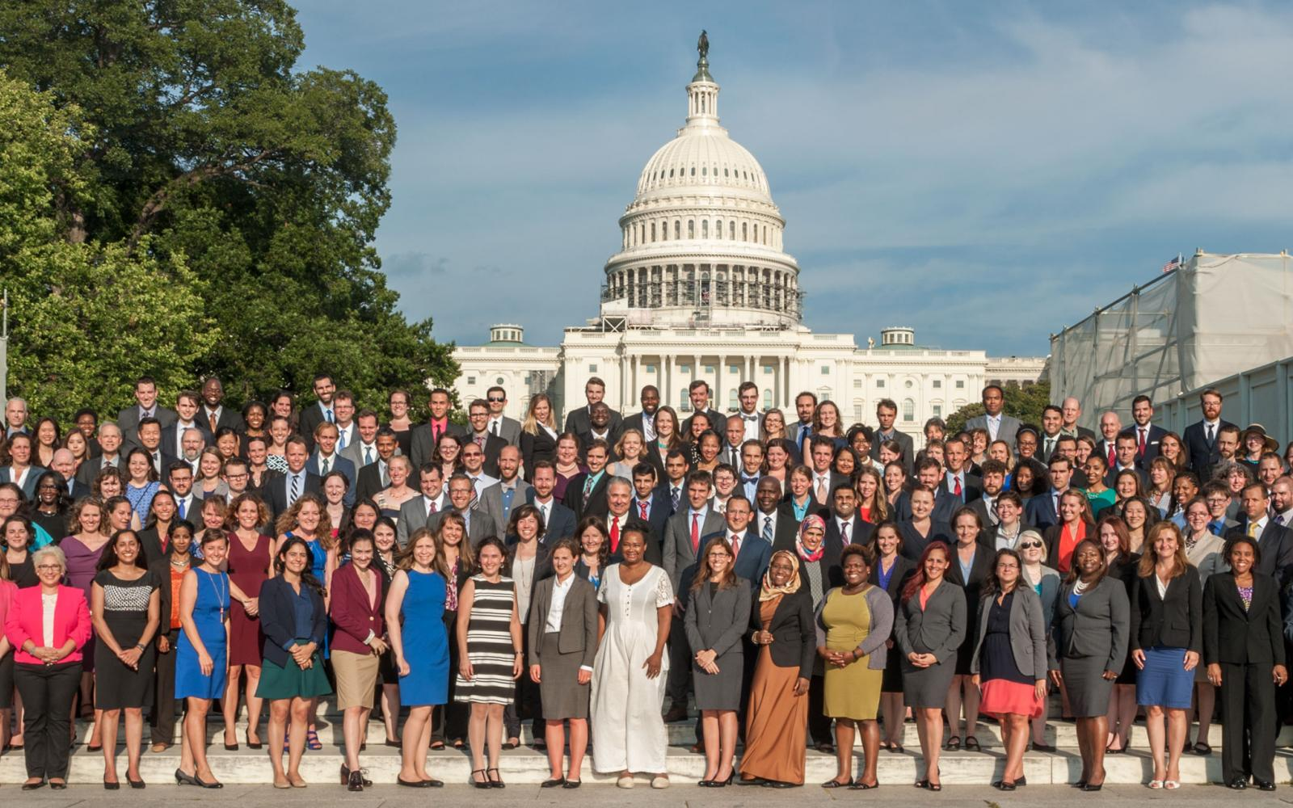
How can I transition into Science Policy?
Notes:
The best way is to transition into science policy is to complete a science policy fellowship. You could earn a certificate or MS in science policy but the AAAS fellowship is the gold standard.

Slide 16
Science Policy Fellowships
AAAS Science Policy Fellowship Application – November
ACS Science Policy Fellowship - January
Mirzayan Science and Technology Policy Fellowships - September
Presidential Management Fellows Program - October
ASBMB Science Policy Fellowship – May
AIBS Graduate Student Policy Intern and Fellowships – Rolling application
Hellman Fellowship in Science and Technology Policy – August
California Science and Technology Policy Fellowship - February
Research America! Science Policy Fellowship – As needed
ASHG/NHGRI Genetics and Public Policy Fellowship – April
Commissioner's Fellowship Program – May
ASM Congressional Science Fellows - February
Health Security Partners Health Security Fellowship – As needed
Notes:
This is a list of the main fellowships available to PhD scientist and the application deadline timing.

Slide 17
Science Policy Fellowships - continued
American Society for Pharmacology and Experimental Therapeutics Washington Fellows Program – September
The American Association of Immunologists Public Policy Fellows Program – January
American Physiological Society Early Career Advocacy Fellowship
American Society for Nutrition Science Policy Fellowship – December
Women’s Research and Education Institute Congressional Fellow on Women and Public policy – June
Canadian Science Policy Fellowship - April
IEEE Government Fellowship - December
Professional Science and Engineering Society Fellows
Society for Neuroscience Early Career Policy Fellows program
US Secretary of State Jefferson Science Fellowship
Civil Services STEM Fellowship Program – January
Department of State Virtual Fellows Program - Part-time unpaid

Slide 18
Science Policy Fellowships
The Royal Society MP-Scientist Pairing Scheme (UK) - July
Harvard – Belfer Center, Science, Technology, and Public Policy Fellowship
Robert Wood Johnson Health Policy Fellowship - November
Harkness Fellowship
Academy of Medical Sciences Policy Internship (UK) - Australia in September and UK, France, Germany, Norway in November
David A Winston Health Policy Fellowship - October
National Center for Health Statistics – Health Policy Fellowship Program
Packer Policy Fellowships – Australian American Health Policy Fellowships
ASPH CDC Allen Rosenfield Global Health Fellowship Program
The Shorenstein APARC fellowship in Asia Health Policy
American Physical Society - January
American Institute of Physics and Member Society Government Science Fellowships - November
Optical Society of America – Congressional Fellows Program - January
American Psychological Association
Notes:
This list highlights fellowships that may be for specific disciplines, MDs or certain nationalities.

Slide 19
OPTIONS Science Communication and Advocacy Community
Options is a community based career development program.
An advisory committee of PhD professionals in both science policy and science communication oversee the programming and community.
Monthly workshops focus on creating a relevant product like a blog post or a lay summary that can be used in the job search.
Participants are matched with alumni professionals who serve as career guides.
The community programming concludes with a strategic career plan aimed at developing the skills and gaining the experience needed for a successful career transition.
Notes:
The Professional Develop and Career Office host Career Communities and one of the communities is Science Communication ad Advocacy. An advisory committee provided insight into the curriculum and activities. Activities include PowerPoint karaoke to improve your ability to spontaneously answer questions about any scientific paper, writing an opinion piece and crafting an effective lay summary. The community meets monthly and everyone will be matched with an alumni science policy professional who can provide career guidance.

Slide 20
Science Policy Communication and Engagement Johns Hopkins PhD Student Group
Website
Mission
To engage in conversations and facilitate projects at the intersection of science, policy, and civic engagement.
To engage with elected representatives and their staff on policies related to science, medicine, and public health
To create educational content that promotes science literacy and policy understanding
To highlight career opportunities in science policy and advocacy, and to learn from the experts
Notes:
You can also gain great experience by joining the Science Policy Communication and Engagement Group at Johns Hopkins.

Slide 21
Biomedical Careers Initiative Internships
FASEB
Health Security Partners
ASBMB
Ripple Effect Communications
BCI Website
Notes:
One of the best ways to transition into a career is to complete an internship. It will also help you know if you actually like doing the work or not. The BCI program offers internships doing science policy work and these are organizations who have offered science policy internships in the past. You can also find science policy internships outside of BCI.

Slide 22
On-Line Training
Union of Concerned Scientists
So What do you do Exactly? How to Talk about the Value of your Research
So you want to work in Science Policy
A Scientist Guide to the Media
Penning an OpEd that will get published
AAAS Science and Technology Policy Leadership Seminar
AAAS on line courses
Careers in Science Policy
How to Communicate with Congress
Communicating Science : Fundamentals for Public Engagement
Engaging in Science Policy
Understanding The Federal R&D Budget
Notes:
There are also some great online course and modules you can engage with. There are small fees associated with the AAAS on line courses.

Slide 23
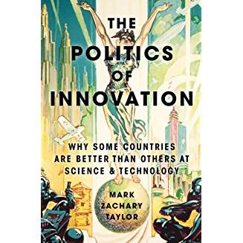
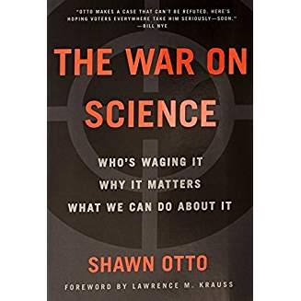
Science Policy Books
Notes:
These are some great books to read and will provide conversation points when networking with other professionals. If you like science policy, you should enjoy reading these books.

Slide 24
Beyond Sputnik: US Science Policy in the 21st Century
Internships and Fellowship Listing
Conferences and Seminar List
Science Policy Degree Programs
Teaching Science Policy
Getting Involved and Careers
Resources – videos, presentations, newsletters, statistics
Website
Notes:
One of the books authors host a great website you should keep abreast of.

Slide 25
Additional Resources
Nontraditional Careers: Science Policy ASCB Sept 16th 2014 by Christina Szalinski
ACS Science Policy Careers
From Bench Scientist to Policy Analyst by Viviane Callier, Januray 5th, 2016
From Pipettes to Science Policy Trends in Immunology, November 2015, Volume 36, No. 11, pages 663 to 665 by Yvette Seger
Yeonwoo Lebovitz: Scientists for Policy – Interview with Libby Barksdale, PhD BEST Oct 5th 2016
More to Science: Working as a Science Policy Analyst Dana Berry Biomed Central Feb 16 2016
Notes:
If you would like to read more about science policy careers here are some great resources.

Slide 26
PDCO Website
https://pdco.med.jhmi.edu
Notes:
We also have a career overview on the PDCO website that includes additional information like internships in addition to an interview with Jason Rao, The American Society for Microbiology Senior Director for Engagement and Innovation. Jason also was a senior science policy advisor for the Obama Administration. How cool is that? If you have more questions, would like to adapt your resume for a science policy career or want to connect with professionals in the field, make an appointment with the PDCO. We work for you!

